Slide 1
Public sentiment to coronavirus in the U.S.
Jessica Gao

Slide 2
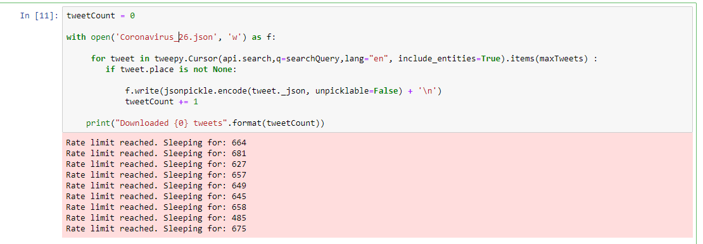
Process
Get Data
Twitter Search API
（about 7000 Tweets）
Not available to specifically collect one tweet’s all replies in a required period
15 calls every 15 minutes
Duplicated tweets
(filter by tweet_id)
Date

Slide 3
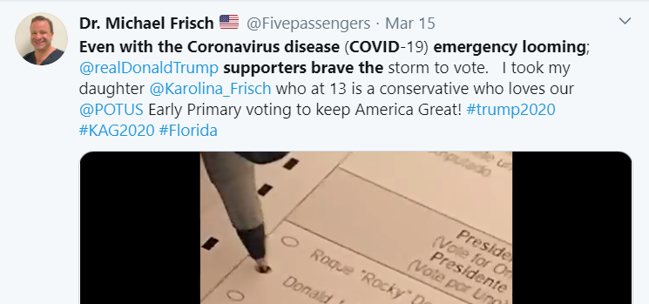
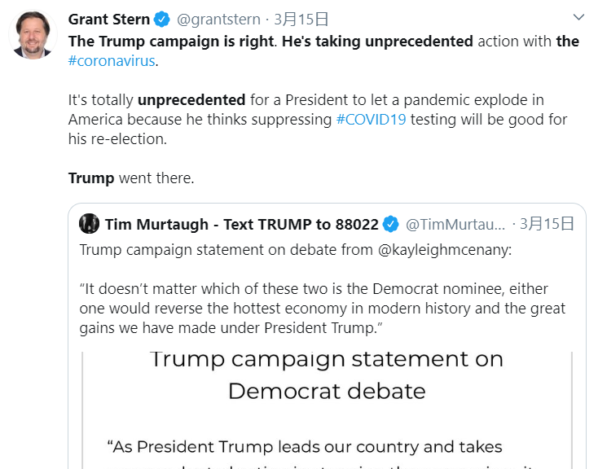
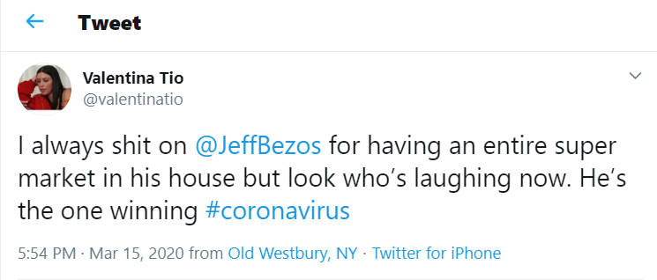

Process
Get Data
Twitter Search API
Label Tweet Data
（4001）
To label data for sentiment analytics is the most difficult work.
TextBlob() helps a little but a tedious work
Principle: Due to social media’s entertaining feature, some tweets are more like jokes which may not be a real negative emotion. Yet, since this is basically a social study, the standpoint is set at the U.S. government.

Slide 4
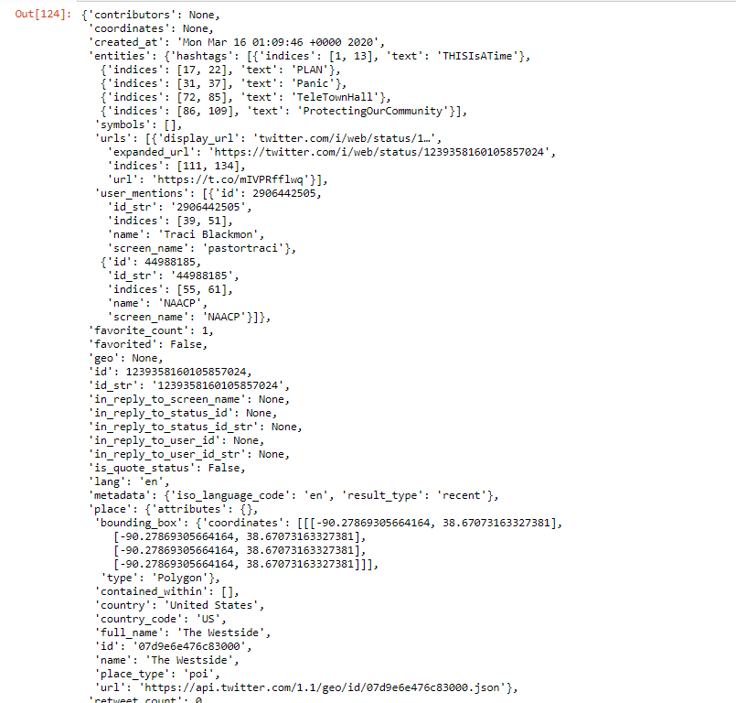
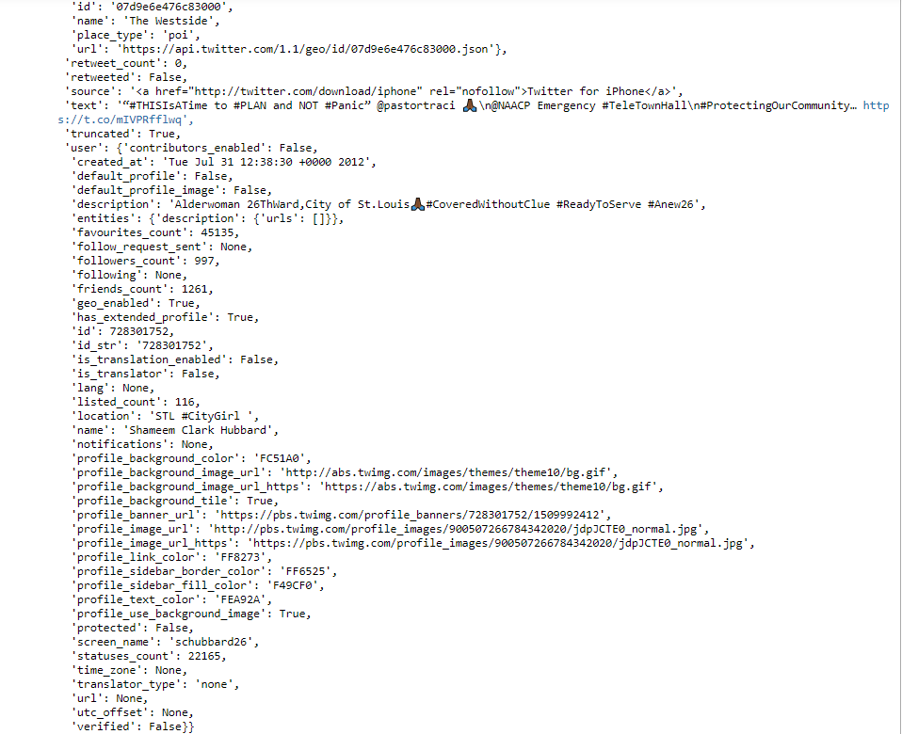

Slide 5
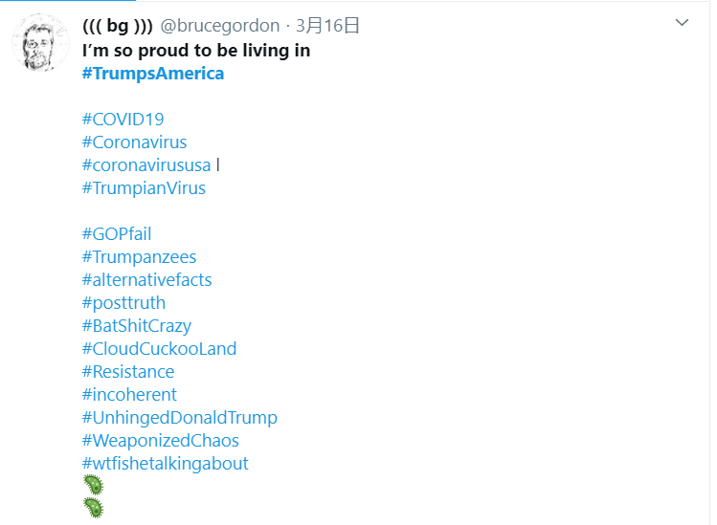
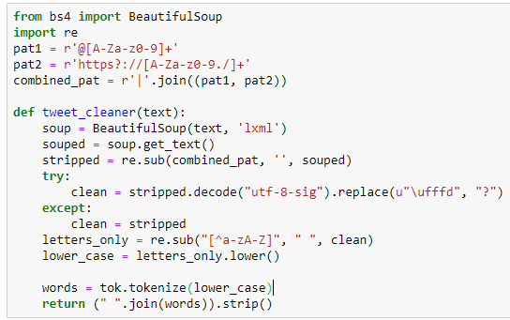
Process
Get Data
Twitter Search API
Label Tweet Data
（4001 Tweets）
Data Cleaning
I’m, It’s, We’re
I m, It s, We re
Problem
Whether to keep cleaned hashtags?
#ThisIsTime
ThisIsTime

Slide 6
Process
Preparation
Get Data
Twitter Search API
Label Tweet Data
（4001 Tweets）
Data Cleaning
Operation
Word Frequency
From every perspective
Model Building and Prediction
Further Text Analysis
Logistic Regression + doc2vec
Geographic Distribution
Tool: Python, Tableau
Library: nltk, sklearn, wordcloud, tensorflow, pandas, numpy
MSE: 0.232, R2: 0.768, F1_score:0.8687782805429864
LSTM model
hot topic or tweet_id
Test accuracy: 0.674437940120697
CNN+LSTM model
Timeseries Trend

Slide 7
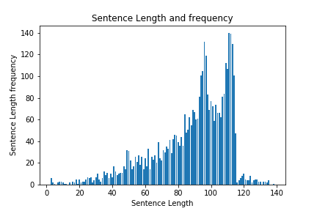
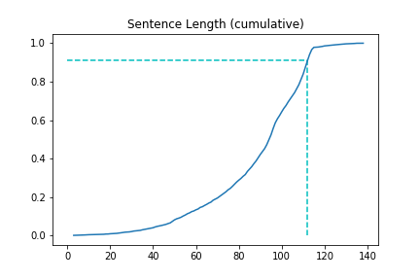

Slide 8
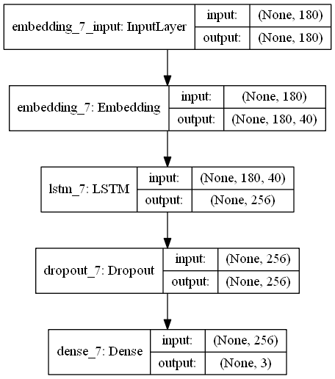
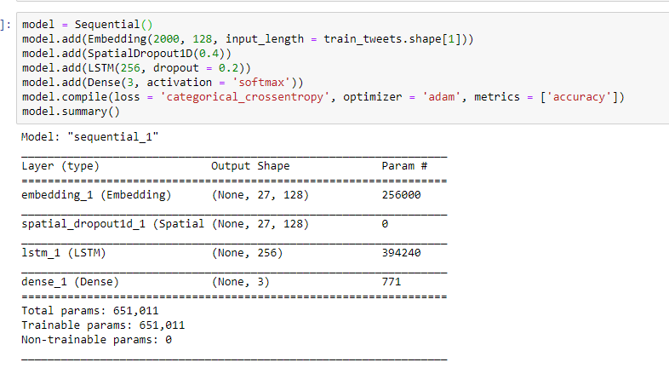
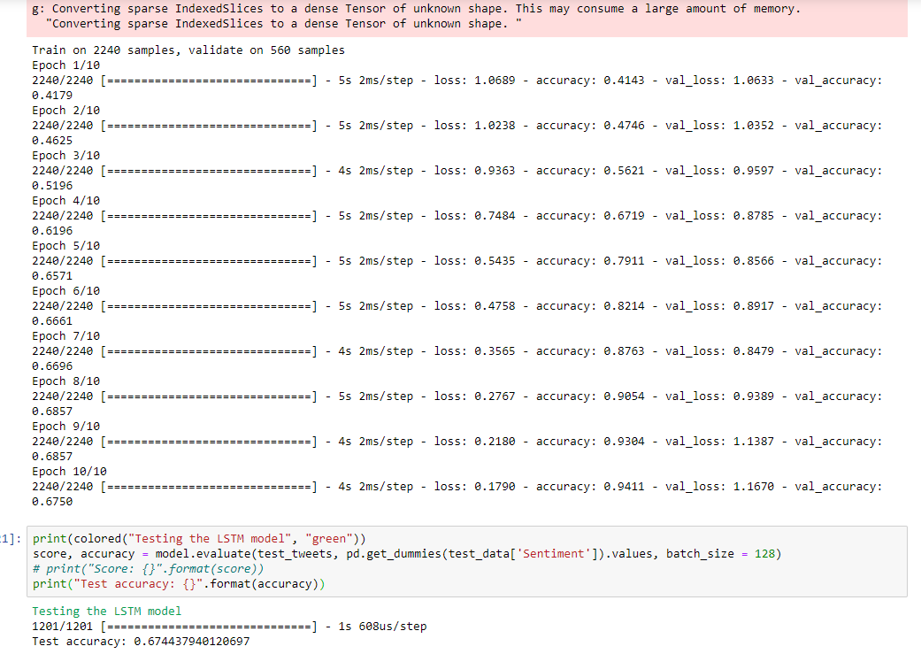
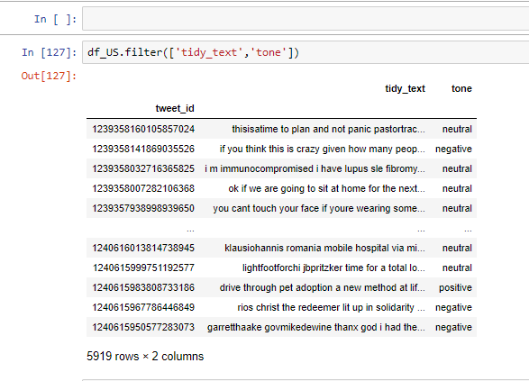
LSTM MODEL rESULT
Test accuracy: 0.674437940120697

Slide 9
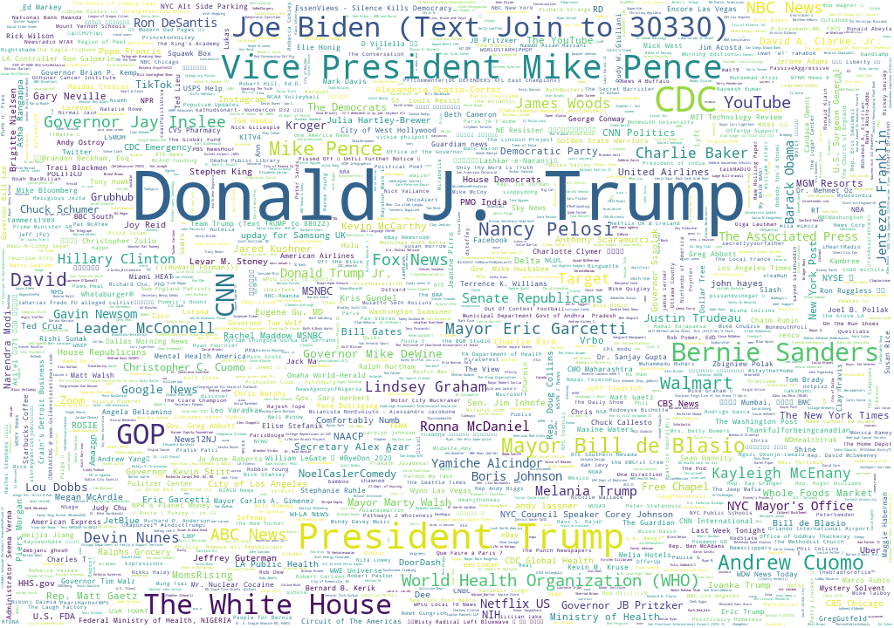
Who is @ most on twitter?

Slide 10
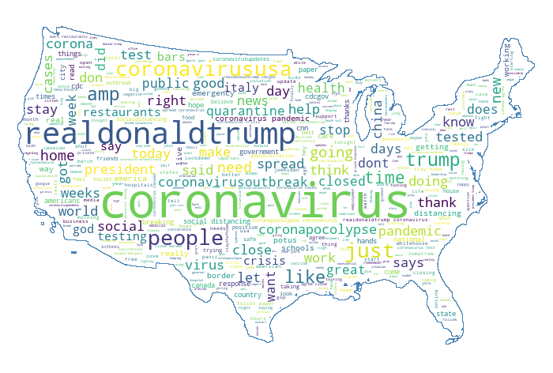
High
Word
Frequency
In All
Tweets

Slide 11
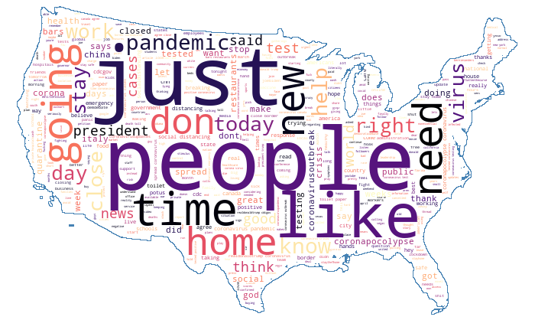

Slide 12
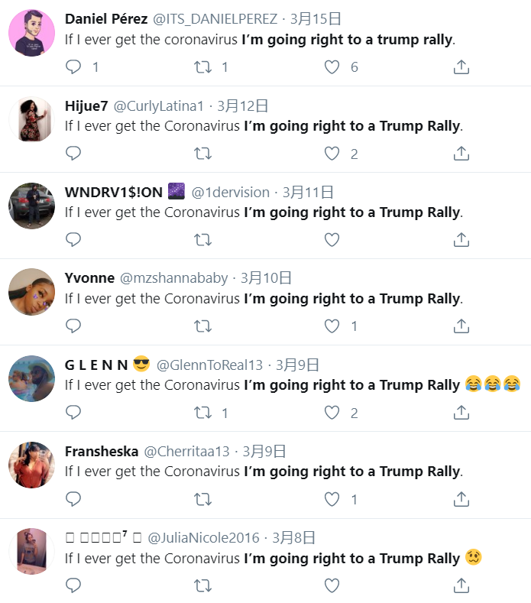

Slide 13
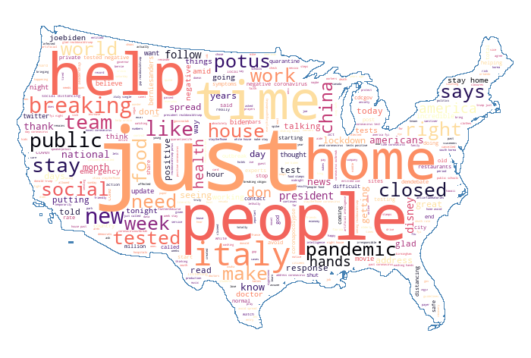
Most ordinary people are easier to be resonated with ‘PEOPLE’
High Word Frequency in All Tweets
High Word Frequency in Hot Tweets

Slide 14
at_mentions | user_id
Donald J. Trump | 1023
CDC | 58
Vice President Mike Pence | 53
Joe Biden (Text Join to 30330) | 37
GOP | 36
The White House | 35
CNN | 29
Bernie Sanders | 28
Mayor Bill de Blasio | 17
Andrew Cuomo | 17
Mike Pence | 16
David | 15
Nancy Pelosi | 15
Walmart | 13
World Health Organization (WHO) | 12
YouTube | 12
NBC News | 11
Fox News | 11
Sentiment Situation relevant to Donald Trump
(accumulative)

Slide 15
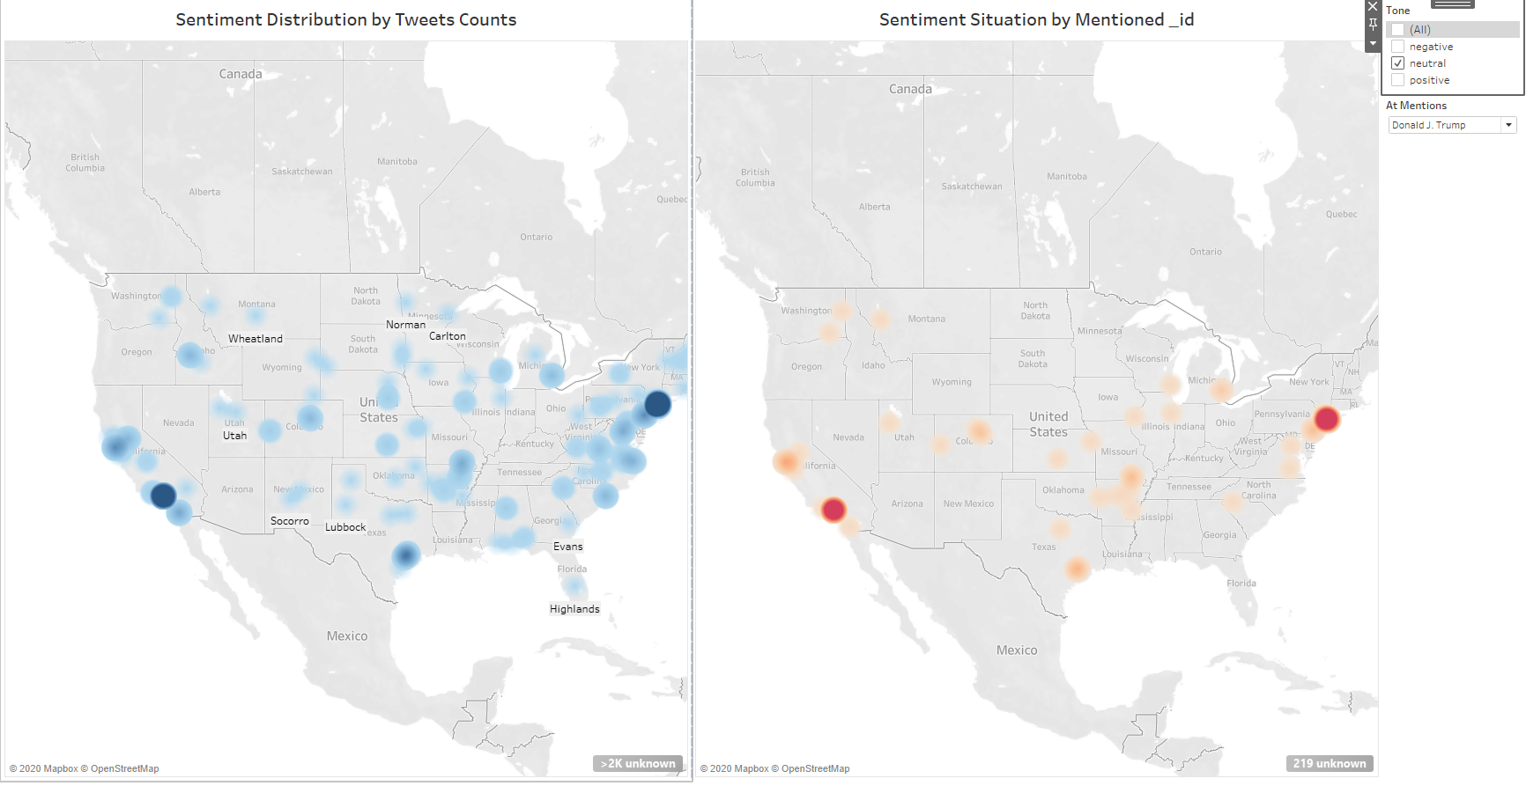
Los Angeles & New York AREAS PAY MORE ATTENTION FOR CORONAVIRUS MORE
https://public.tableau.com/profile/binqian.gao#!/vizhome/ins_map_15846587614580/Dashboard1?publish=yes

Slide 16
NEXT STEP
Beside advanced purely text analytics models which improve the interpretation through content context, we maybe need to include the features of the person who post this tweets, since people’s language senses vary.
User Classification-- Know him/her better, Understand him/her words better

